Slide 1
What We
(and better yet, our students) Learned From Using All the Toys in the Toybox
Jill Smith
University of Maryland
Francis King Carey School of Law

Slide 2
Background
Facts
Challenges
Mandatory class
Taught 2d semester 1L year
Half-semester
Semi-“Flipped” classroom
Half-semester, 1-credit class
History of minimal in-class interaction
Library faculty were unknown quantity

Slide 3
Choose you own adventure!
Low-Voltage
Tech
Videos &
Quizzing
Review
Exercises
Spin the Wheel!
Clickers
CALI
Lessons
Student
Narratives
In Class Exercises

Slide 4
What we learned
Habits are ingrained – don’t fight them, use them
  Start with Google
  Lead on to Google Scholar
Modeling behaviors
Value of switching up techniques
Where are the gaps?
Notes:
Allow Google (and their knowledge that Google and Wikipedia aren’t always reliable) to provide a platform that is comfortable and familiar
By utilizing different tools and techniques, we are inherently modeling flexibility
Much talk about DNs is nonsense – but they do have a short attention span. Switching techniques helps to capture and keep attention.
Switching up techniques and opening dialogue allowed us to spot more gaps in their knowledge prior to the final paper

Slide 5
What they learned
Go beyond search
  Use tools
  Switching techniques and the 15-minute rule
Polish
Self-knowledge re: gaps
Print works – not so scary
Notes:
Hard to get students to get out of text-search mode, but when we modeled so many different behaviors it made changing techniques seem more organic
Fewer papers exhibited “flat forehead” syndrome
Fewer papers whose vocabulary reach exceeded their grasp
Greater metacognition and self-knowledge re: gaps in their own knowledge.

Slide 6
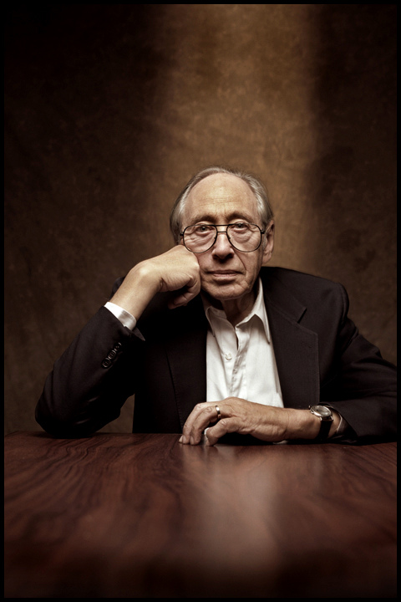
Flexibility and Problem-Solving
“The illiterate of the 21st Century will not be those who cannot read and write, but those who cannot learn, unlearn, and relearn.”
– Alvin Toffler
Creative Commons licensed image of Alvin Toffler: http://en.wikipedia.org/wiki/File:Alvin_Toffler_02.jpg by Vern Evans

Slide 7

Questions?
Jill Smith & Camilla Tubbs
University of Maryland
Francis King Carey School of Law

Slide 8
Wheel of Instruction

Slide 9
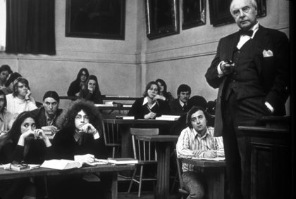
Socratic Method and Legal Research
Notes:
How many of you rely on the Socratic Method?
In looking at new techniques, we didn’t abandon old ones
Other techniques and tools facilitated discussion
“Here, in this room – this is where you get things wrong.” Safe space
Interactions with students highlighted gaps in knowledge.

Slide 10
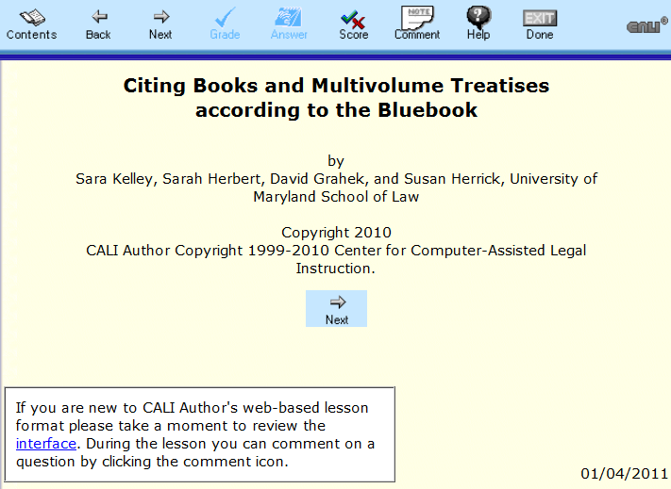
CALI Lessons
Notes:
Duh.
Interactivity w/Bluebook is very valuable – can’t teach this in the abstract.
No “official” lessons used in ILR

Slide 11
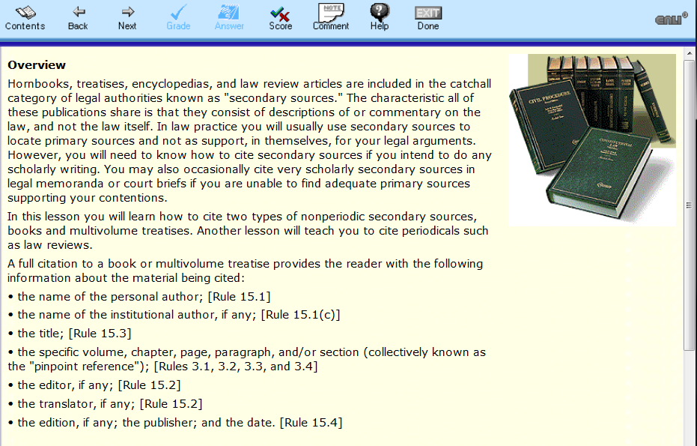
Notes:
Extensive use of CALI in ALR (required class)
Database of CALI lessons pre-vetted by Jenny

Slide 12
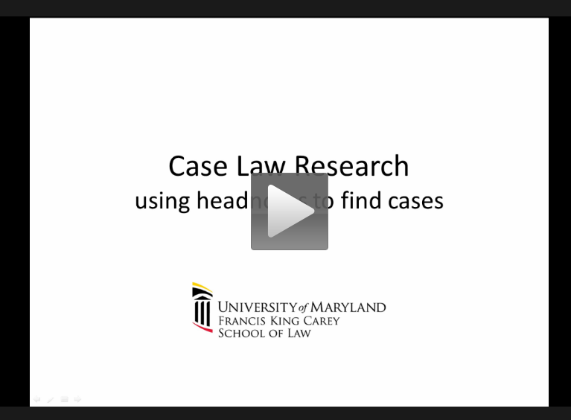
Videos & Quizzing
Notes:
Had always used videos in the past (Camtasia 8)
Starting to incorporate quizzing as part of the video homework
Gets students out of receptive mode and into interactive mode (similar to Polling)
Students have indicated they would prefer even shorter videos

Slide 13
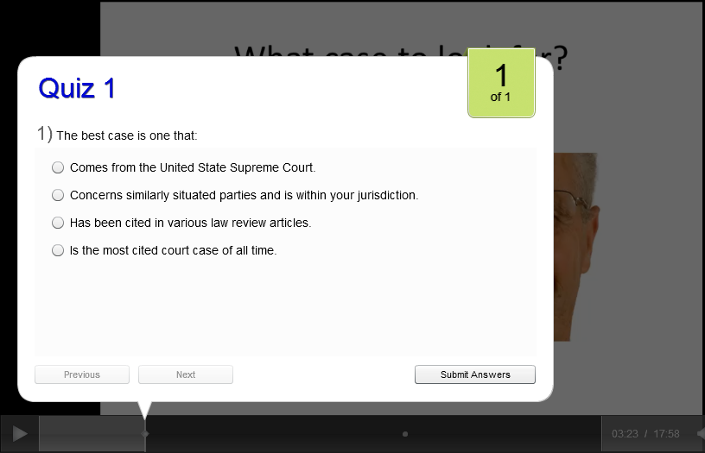

Slide 14
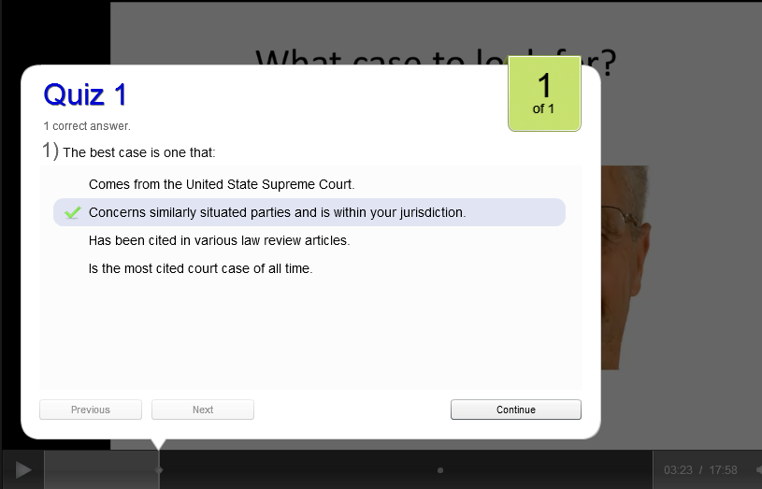

Slide 15
Review Exercises
James, a Vice President at Brookline Corporation, located in Beltsville, Maryland, purchased a tract of land near corporate headquarters in 2008. At the time of the purchase, Brookline was considering expanding its headquarters; however, a decision on the location had not been made. James thought he would either sell the land back to the corporation if it was needed for the expansion or build a house on it for his family. Brookline recently announced its expansion plan which includes acquiring James’s property. The property is still a vacant lot but the value has skyrocketed as a result of Brookline’s announcement. James would like to sell the land to the corporation at its current value. You have been asked to research whether James’s purchase of the land violated his fiduciary responsibility as an officer of the corporation.
Notes:
Older technique, using Blackboard
Current inflection point for future planning – initial use of quizzes in screen-capture videos was successful, might use more of that for contextual exercises.
Most helpful when questions can be multiple choice, though we have done essay questions with model answers
Class participation

Slide 16
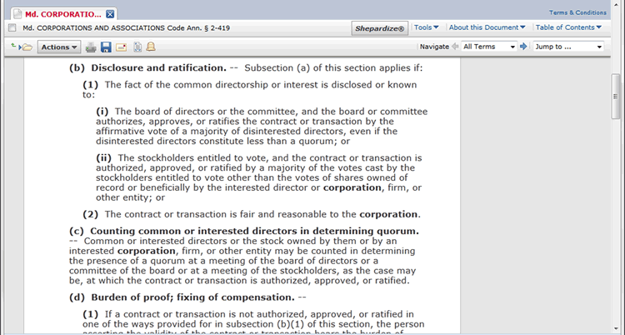
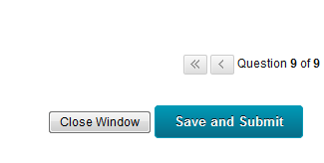


Question: An article in the Delaware Journal of Corporate Law available in Lexis cites to this section in a footnote. Is the source shown in this screenshot (select all that apply):

Slide 17
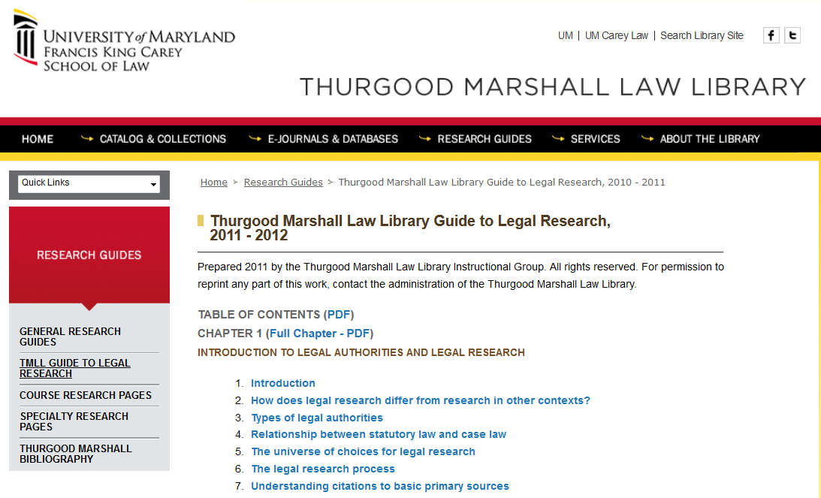
Print 2.0
Notes:
Biggest surprise for everyone
Students didn’t hate it (this surprised them too)
Increased exposure led to increased understanding and use
Teamwork & research as a collaborative activity – easier to do with paper.

Slide 18
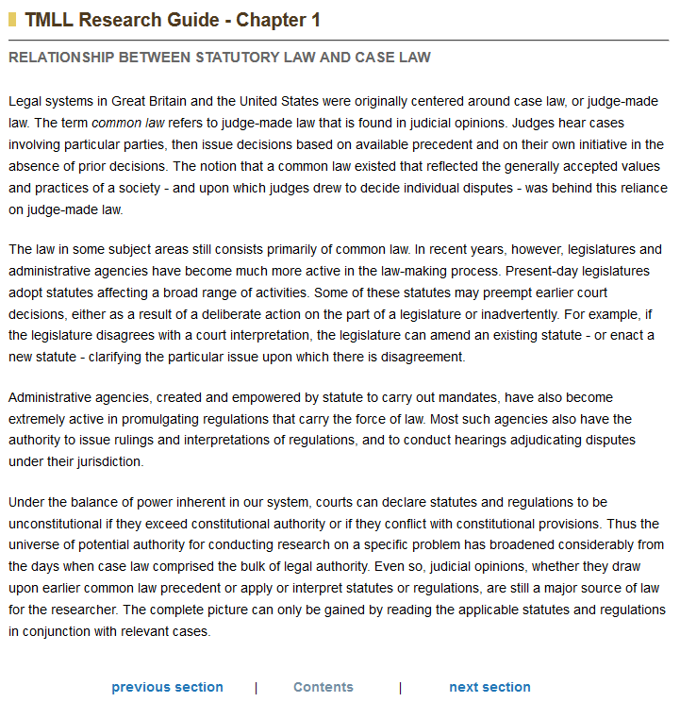
Notes:
Better searches and more structural awareness of how online resources are organized

Slide 19

Print is dead? Not so fast…
More than 50% of firm lawyers report using print materials regularly for research *
* 2012 American Bar Association Legal Technology Report, V-25.
Notes:
Playing to their enlightened self-interest.
Story of Camilla’s student
Story of Bluebook indexes

Slide 20
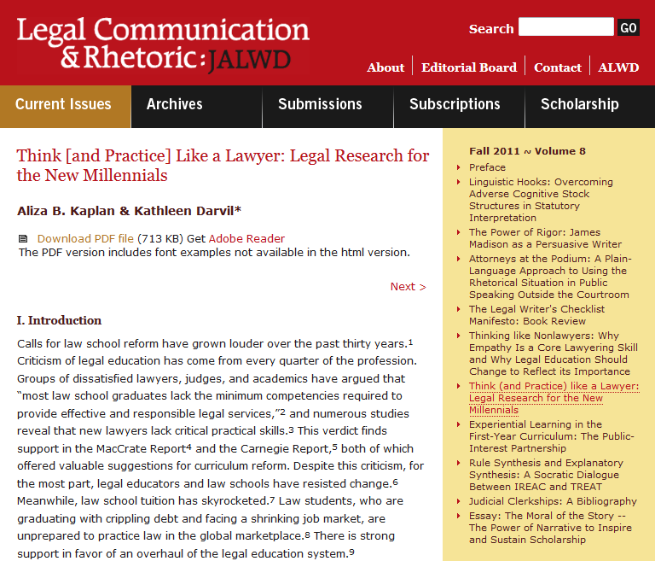

Slide 21

“Because legal research instruction focuses on teaching how to use the two main electronic legal research platforms, Westlaw and Lexis, rather than on how to understand the structure of law, new lawyers do not understand how to research the law conceptually. The danger in all of this is that in their search to find the “perfect” case, new attorneys either fail to retrieve or overlook key authorities and therefore miss the fundamental principles governing the issue.”
Notes:
Speed
Failure to recognize patterns
When no perfect case is found, sometimes they gravitate towards more shiny cases (e.g. SCOTUS) and ignore more on-point persuasive authority

Slide 22
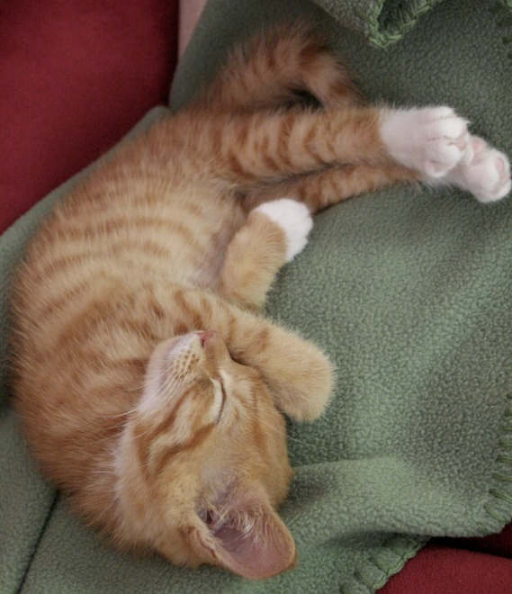
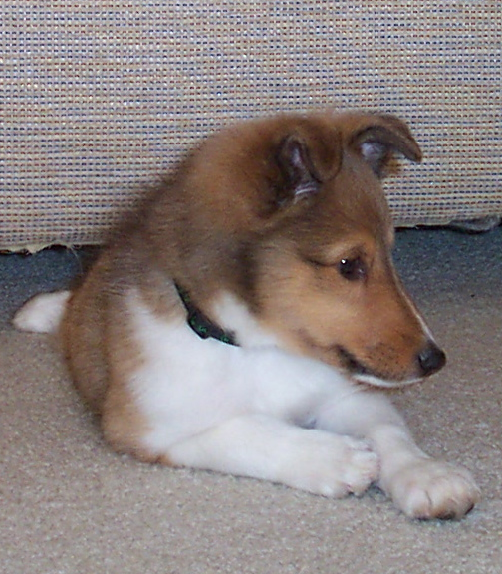
Clickers – pollev.com/jaslawlib
Which animal is cuter?
Kitten
Puppy
I can’t decide!
Notes:
The “no stakes” test slide
Settles presenter
Assures everyone that system works
Gets students into interactive mode (similar to quizzing)
Gets students out from behind their laptops.
Students started asking for polling quizzes – how often do students look forward to a part of class?

Slide 23
What type of authority is being displayed here?
Primary
Secondary
What type of authority is being displayed here?
(A) Primary (B) Secondary
Georgia Code Annotated, § 10-1-761
§ 10-1-761. Definitions
(3) “Person” means a natural person, corporation, business trust, estate, trust, partnership, association, joint venture, government, governmental subdivision or agency, or any other for profit or not for profit legal or commercial entity.
(4) “Trade secret” means information, without regard to form, including, but not limited to, technical or nontechnical data, a formula, a pattern, a compilation, a program, a device, a method, a technique, a drawing, a process, financial data, financial plans, product plans, or a list of actual or potential customers or suppliers which is not commonly known by or available to the public and which information:
  (A) Derives economic value, actual or potential, from not being generally known to, and not
Name that Authority!

Slide 24
What type of authority is being displayed here?
Primary
Secondary
What type of authority is being displayed here?
(A) Primary (B) Secondary
Georgia Code Annotated, § 10-1-761
§ 10-1-761. Definitions
(3) “Person” means a natural person, corporation, business trust, estate, trust, partnership, association, joint venture, government, governmental subdivision or agency, or any other for profit or not for profit legal or commercial entity.
(4) “Trade secret” means information, without regard to form, including, but not limited to, technical or nontechnical data, a formula, a pattern, a compilation, a program, a device, a method, a technique, a drawing, a process, financial data, financial plans, product plans, or a list of actual or potential customers or suppliers which is not commonly known by or available to the public and which information:
  (A) Derives economic value, actual or potential, from not being generally known to, and not
Name that Authority!

Slide 25
Identify the Dicta!
“We find that the spotted owl is protected under the Endangered Species Act. If we were discussing the common white-tailed deer, its great numbers and tendency to eat my garden plants would require a different result.”*
*Not from a real case

Slide 27
What type of authority is being displayed here?
Primary
Secondary
What type of authority is being displayed here?
(A) Primary (B) Secondary
263 Ga. 615
Supreme Court of Georgia
  AVNET, INC., et al.
  v.
  WYLE LABORATORIES, INC., et al.
  WYLE LABORATORIES, INC., et al.
  v.
  AVNET, INC., et al.
  Nos. S93A1393, S93X1576.
  Dec. 2, 1993.
Distributors of electronic components that entered into merger agreement brought action against competitor that hired former employees of one of the distributors, seeking damages and injunctive relief. The Superior Court, Fulton County, Frank M. Eldridge, J., denied motion for interlocutory
Name that Authority!

Slide 28
What type of authority is being displayed here?
Primary
Secondary
What type of authority is being displayed here?
(A) Primary (B) Secondary
263 Ga. 615
Supreme Court of Georgia
  AVNET, INC., et al.
  v.
  WYLE LABORATORIES, INC., et al.
  WYLE LABORATORIES, INC., et al.
  v.
  AVNET, INC., et al.
  Nos. S93A1393, S93X1576.
  Dec. 2, 1993.
Distributors of electronic components that entered into merger agreement brought action against competitor that hired former employees of one of the distributors, seeking damages and injunctive relief. The Superior Court, Fulton County, Frank M. Eldridge, J., denied motion for interlocutory
Name that Authority!

Slide 29
What type of authority is being displayed here?
Primary
Secondary
What type of authority is being displayed here?
(A) Primary (B) Secondary
Callmann on Unfair Competition, Trademarks and Monopolies (4th Edition)
Part IV. Misappropriation of a Competitor's Values
  Chapter 14. Trade Secrets
§ 14:26. The requirements for protection—Precautions to preserve secrecy
The Uniform Trade Secret Act^{0.40} and the majority of recent cases define “trade secret” as information which derives economic value from not being generally known and not being readily ascertainable by proper means by those who are not in a confidential relationship with the trade secret proprietor.^{0.50} Thus, secrecy is the defining characteristic of information which is protectible under trade secret law, and reasonable efforts to preserve that secrecy are essential to qualify for such protection.^{0.60} But there is a minority view: “In determining whether matter is protectable as a trade secret, courts
Name that Authority!

Slide 30
What type of authority is being displayed here?
Primary
Secondary
What type of authority is being displayed here?
(A) Primary (B) Secondary
Callmann on Unfair Competition, Trademarks and Monopolies (4th Edition)
Part IV. Misappropriation of a Competitor's Values
  Chapter 14. Trade Secrets
§ 14:26. The requirements for protection—Precautions to preserve secrecy
The Uniform Trade Secret Act^{0.40} and the majority of recent cases define “trade secret” as information which derives economic value from not being generally known and not being readily ascertainable by proper means by those who are not in a confidential relationship with the trade secret proprietor.^{0.50} Thus, secrecy is the defining characteristic of information which is protectible under trade secret law, and reasonable efforts to preserve that secrecy are essential to qualify for such protection.^{0.60} But there is a minority view: “In determining whether matter is protectable as a trade secret, courts
Name that Authority!

Slide 31
Student Narratives
Launch Video
Notes:
Peer feedback is crucial – students listen when their contemporaries speak
The videos are aging, but still have good points and are appreciated by students
They’re an icebreaker – they let students know they aren’t going through this for the first time
Different personalities in the various videos allow for a good range of reactions

Slide 32

In Class Exercises
Notes:
Semi-flipped class
2-hour class sessions enabled fairly in-depth exercises
Solution for multiple platforms: collaborative work enabled students to demonstrate to each other
Feedback from students after each exercise allowed students to see that there’s no one way to do things.

Slide 33
